Slide 1
GeoNetwork 3 features relevant to OpenWIS 4
By Dominic Woollatt - Met Office
08 March 2017

Slide 2
Links
OpenWIS v4.0
http://cgn-openwis.eurodyn.com/geonetwork
GeoNetwork 3.2.1
http://cgn-original.eurodyn.com:8080/geonetwork

Slide 3
My Observations:
User Experience
Home page
Search page and results
Subscription/ad-hoc (if available)
Admin page
Groups
Privileges
Categories
Users
Blacklisting
Harvesting
Metadata – standards/adding/importing/editing
Reports
Status/Statistics
Batch Process
What’s Missing compared to v3.14
Notes:
Anyone taken a look at v4.0? Or GeoNetwork 3.2 ?

Slide 4
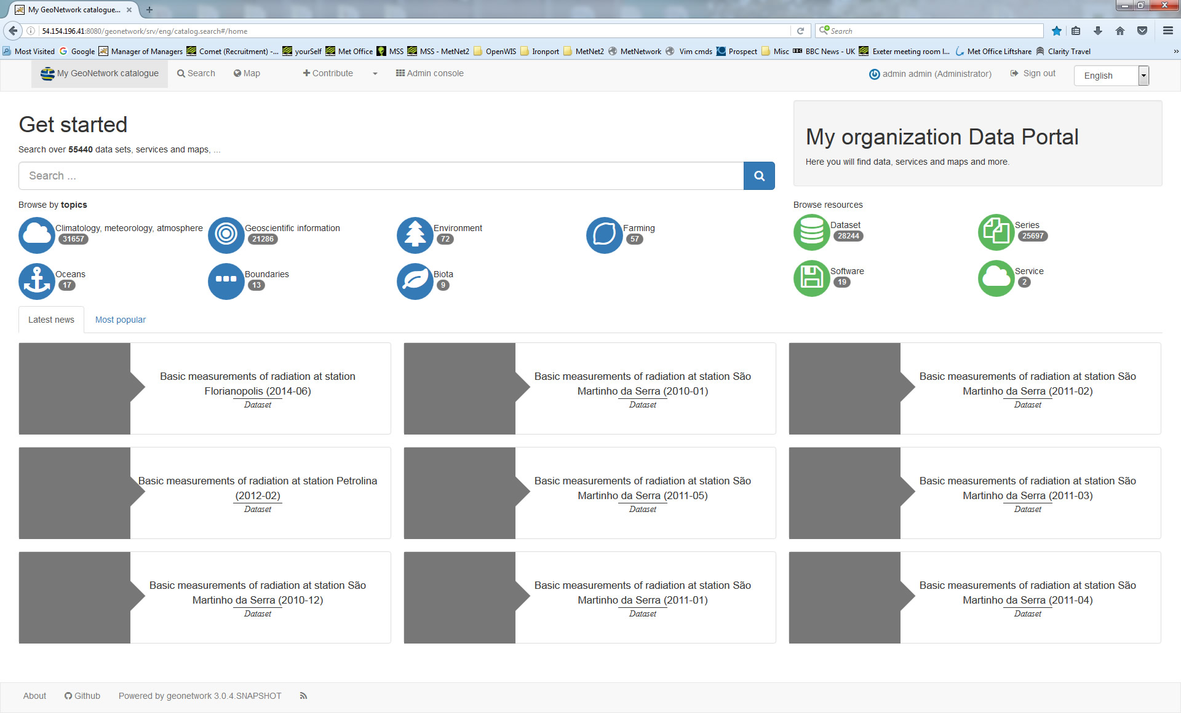
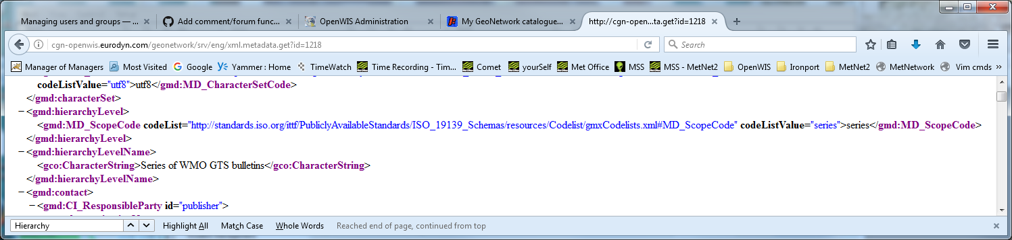
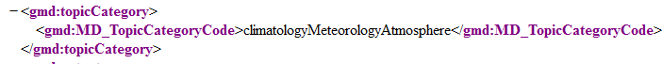
Home page
Notes:
General Layout – ok – but maybe better to have the search page as main page?
Topics – these come from the Topic Category Code in the Metadata – no idea where the icons are set up.
Browse Resources/Types – seems to be generated from ‘Hierarchy Level’ ‘codeListValue’ section in Metadata – no idea where the icons are set up.
How many can be displayed on this page?
Also are we keeping a single portal for both Administration and Users?

Slide 5
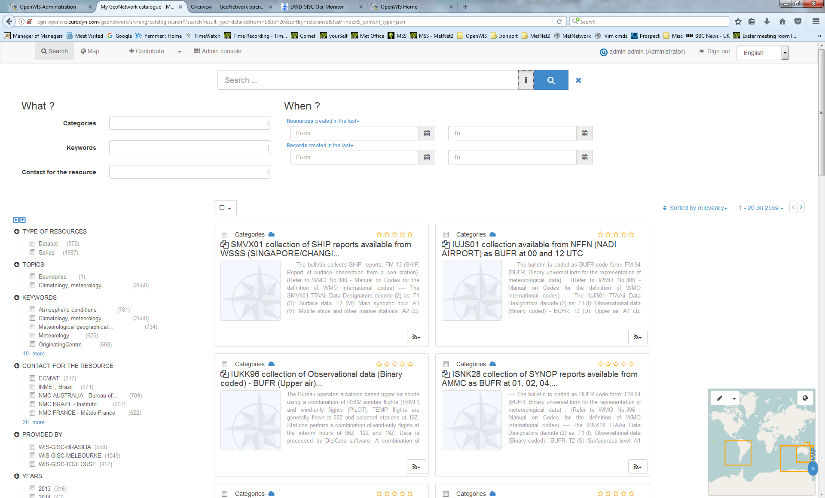
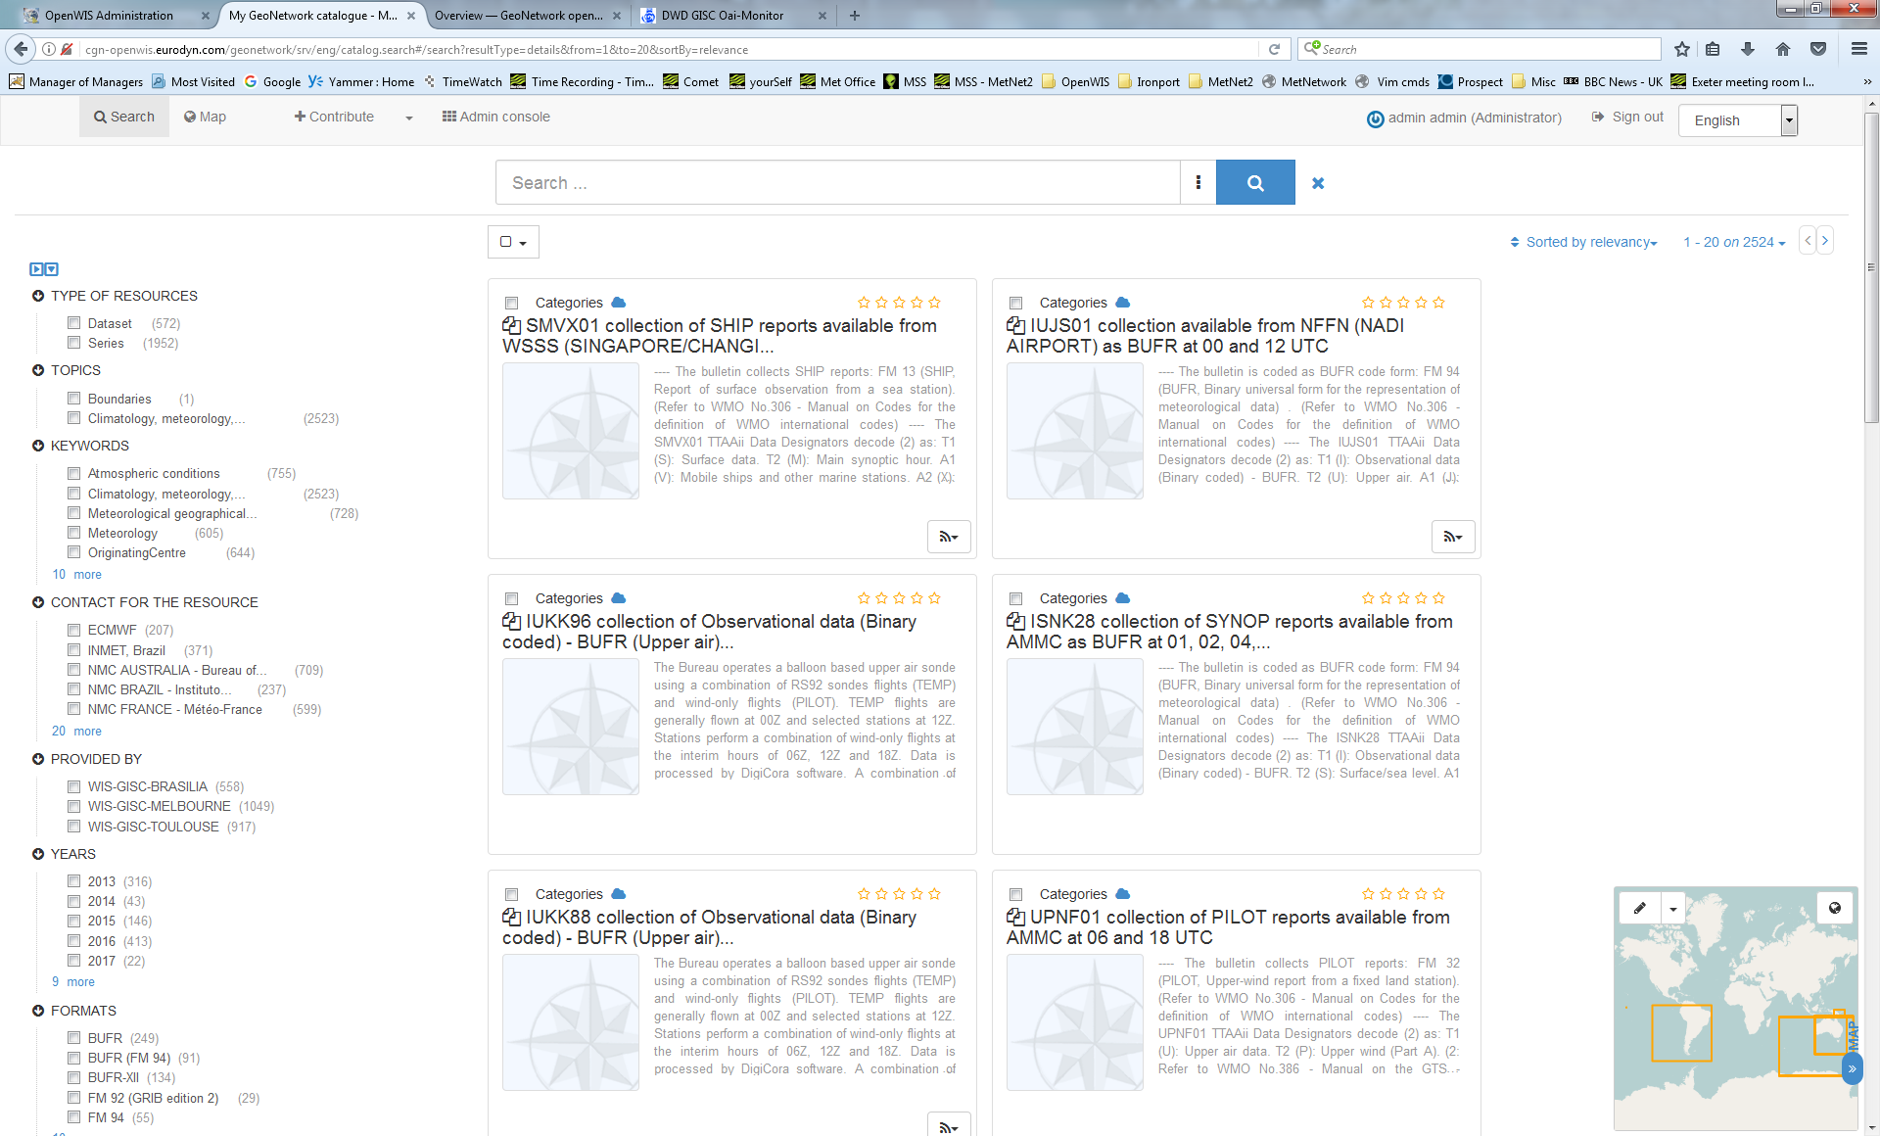
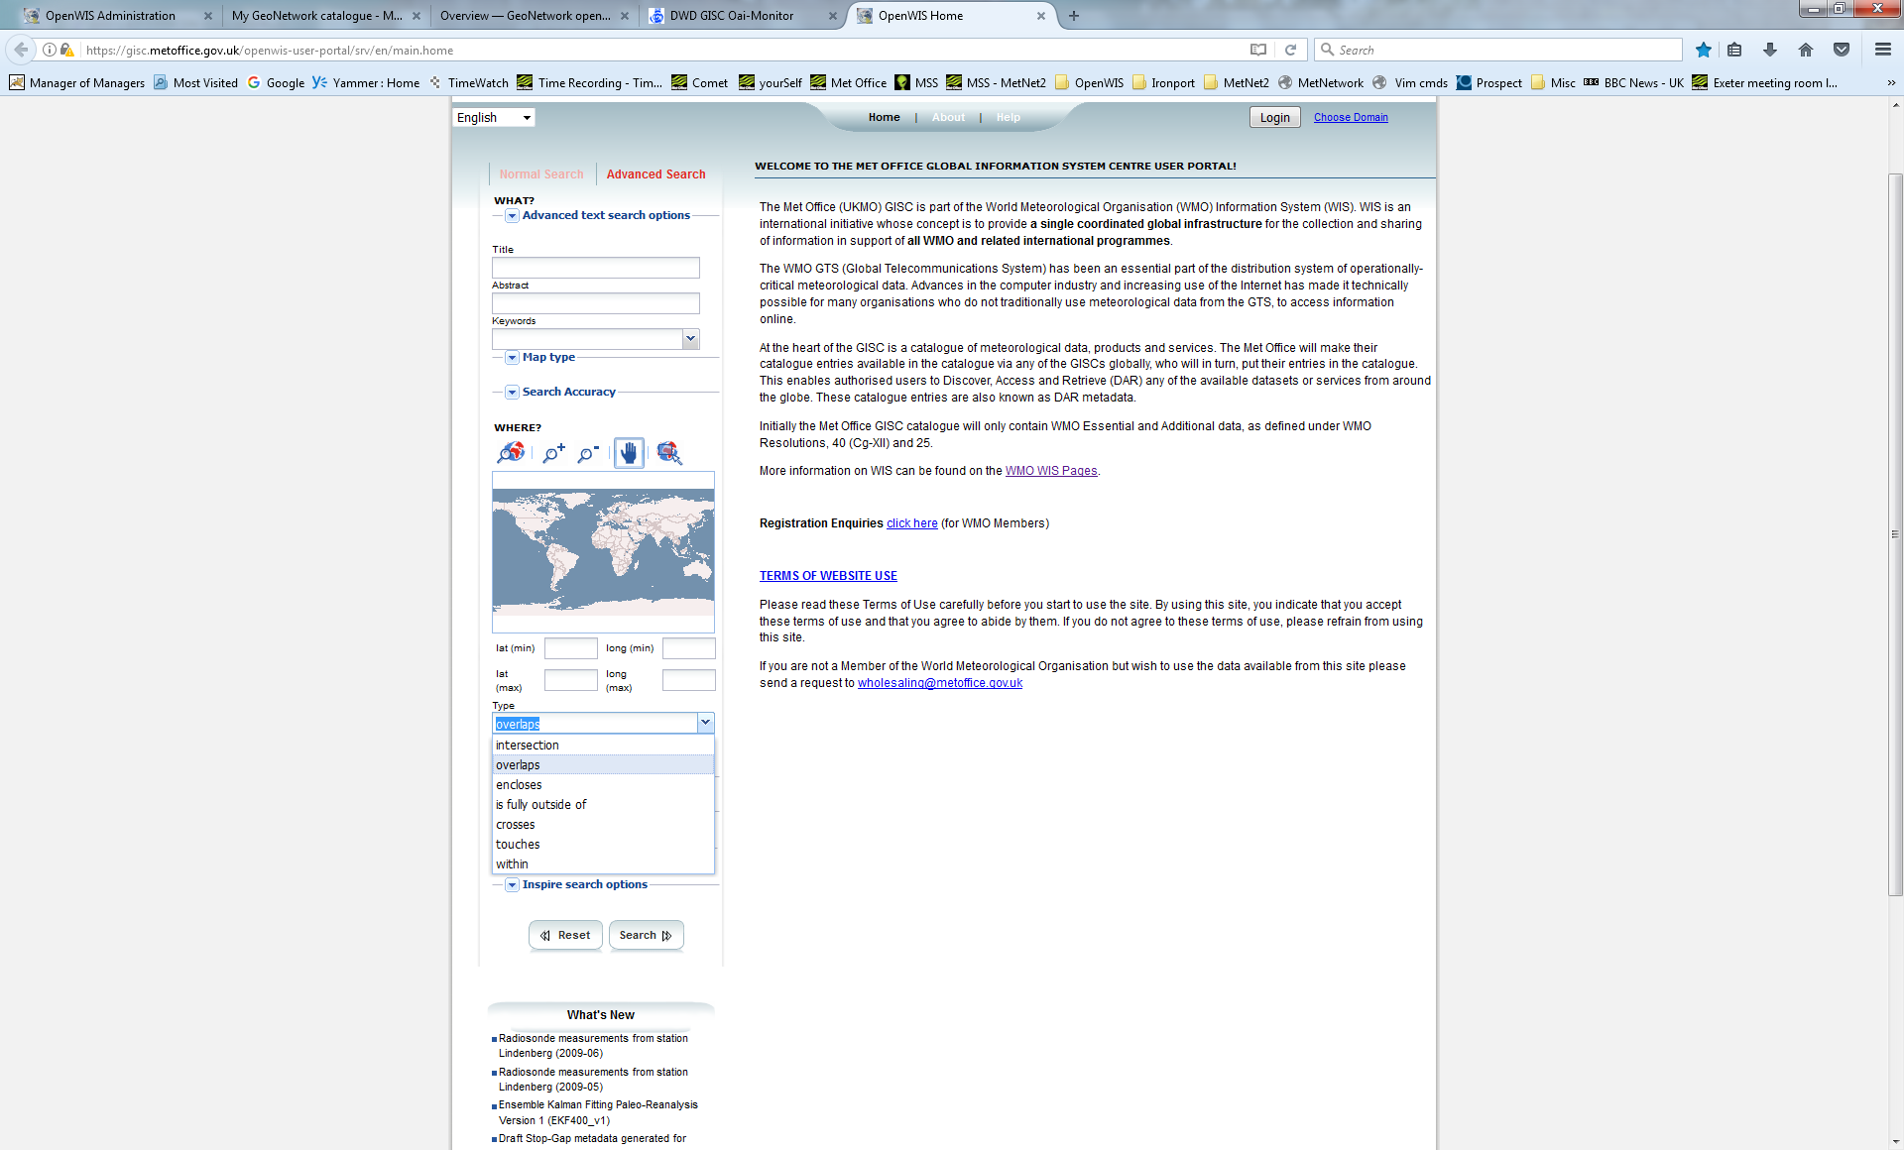
Search Page
Notes:
Left side selection boxes very useful for narrowing search results – need to investigate if configurable? Seems to be limited
Taken from Metadata
Not sure if the map search works as per original OpenWIS requirements. How/where is it configured?
I’m surprised to see searching via Lat/Long missing

Slide 6
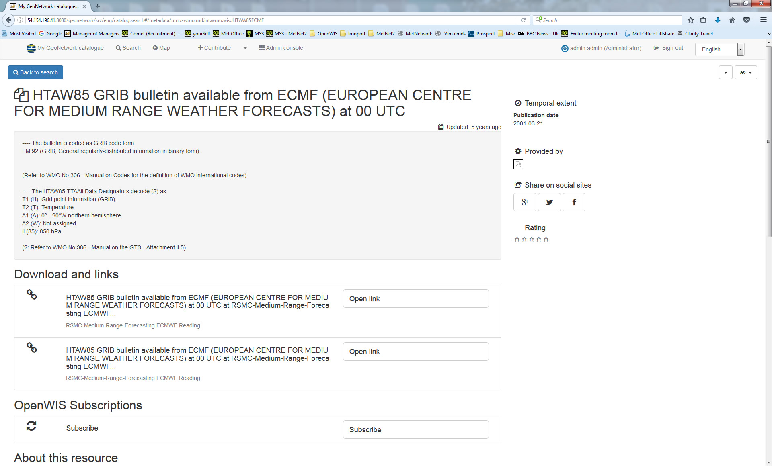
View Metadata
Notes:
Seems ok
Not so sure about ‘Rating’ and ‘Share on social sites’
Provided by missing?
This example has had OpenWIS modifications with subscription section.

Slide 7
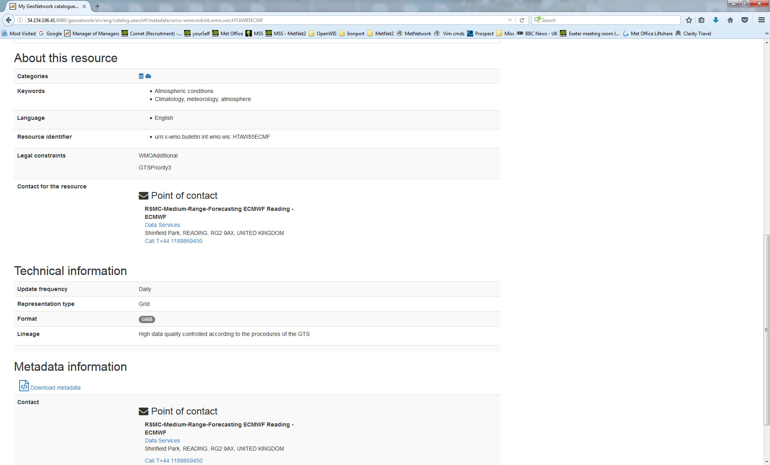
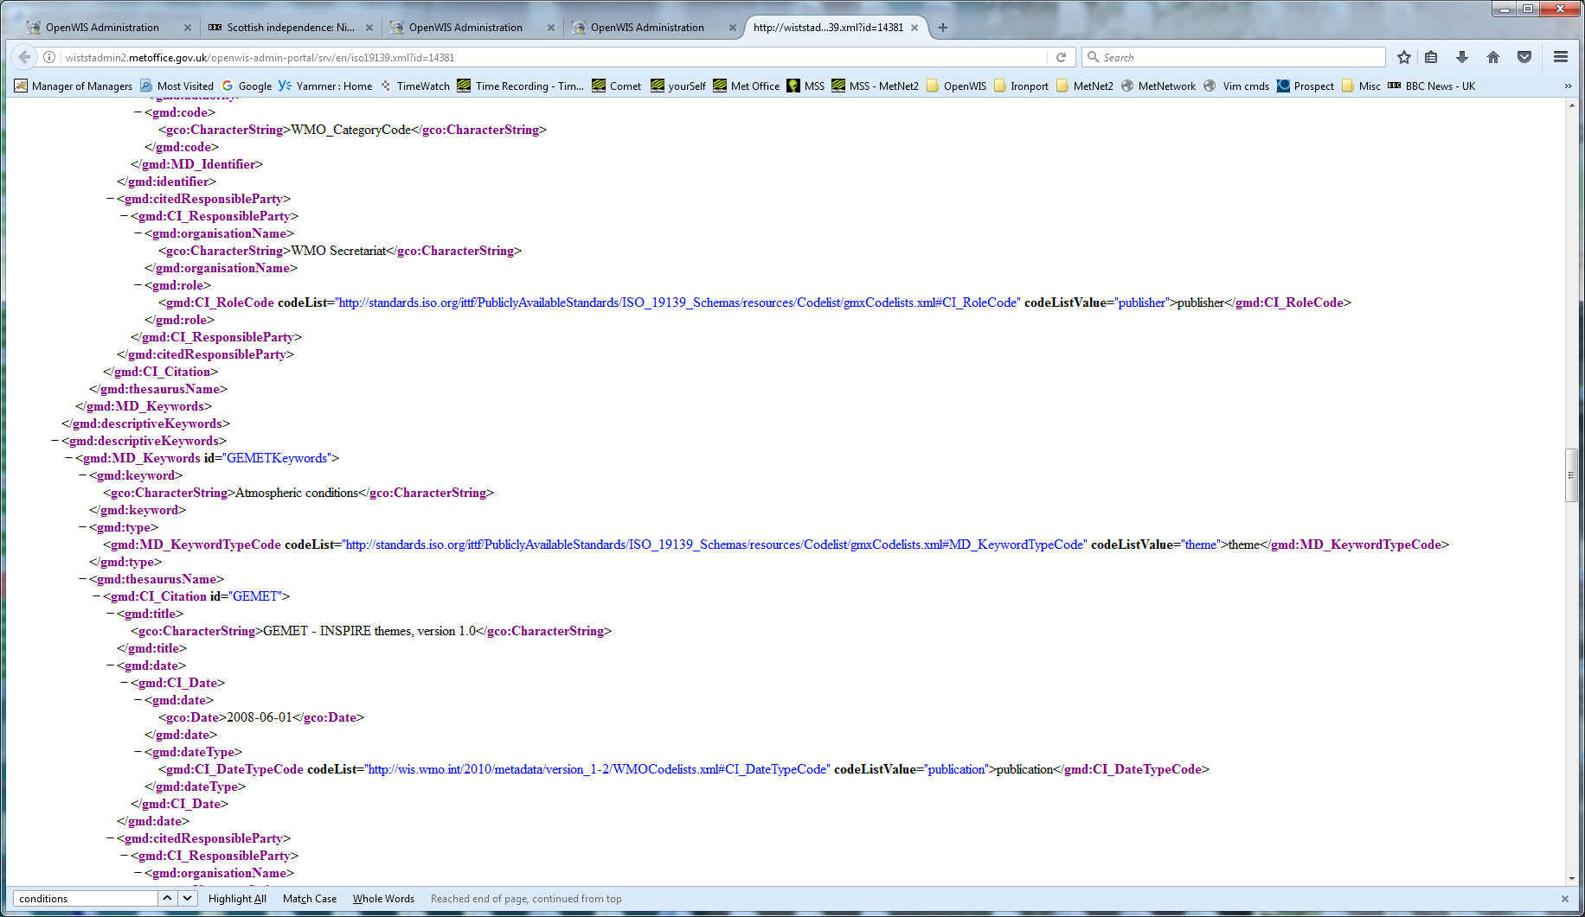
View Metadata cont…
Notes:
We see more icons again. (Nice Touch)
Keywords:
Climatology. Meteorology, atmosphere from a ‘Topic category code’ in the metadata as seen on Home Page
But this time ‘Atmospheric conditions’ comes from a Keyword in the metadata

Slide 8
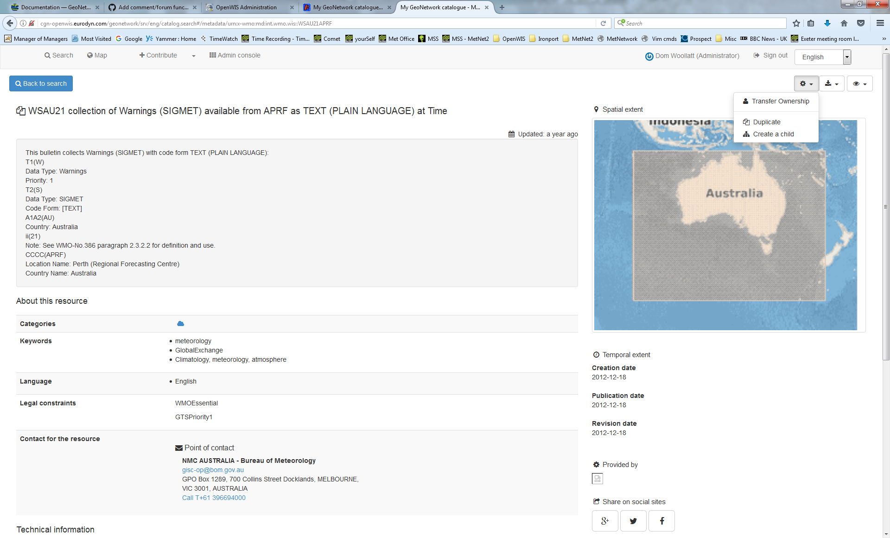
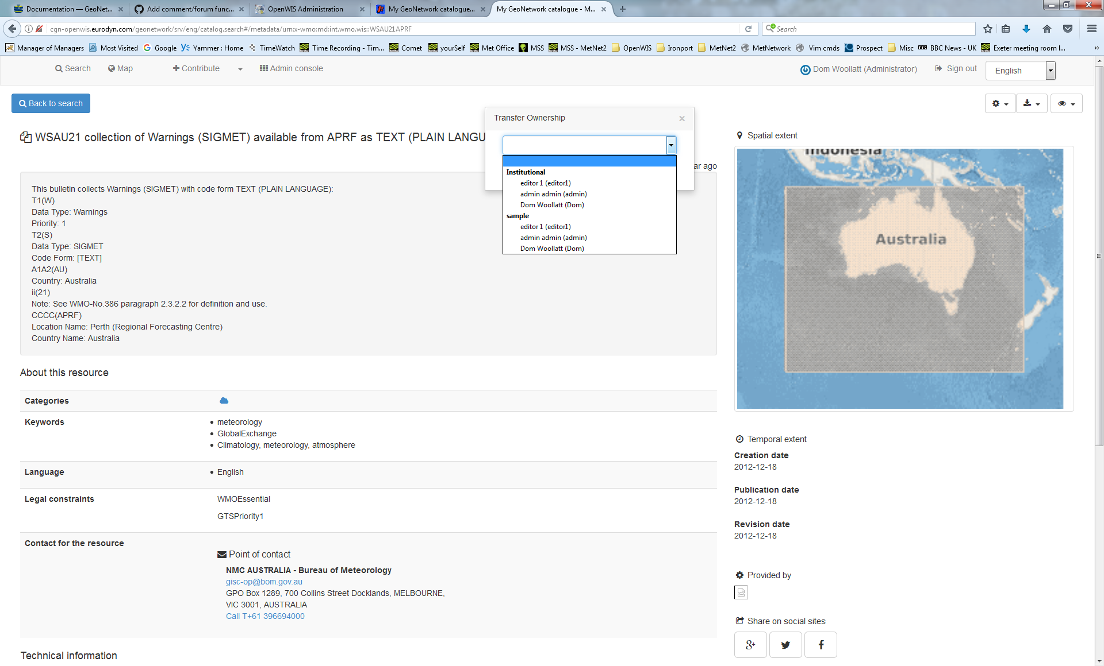
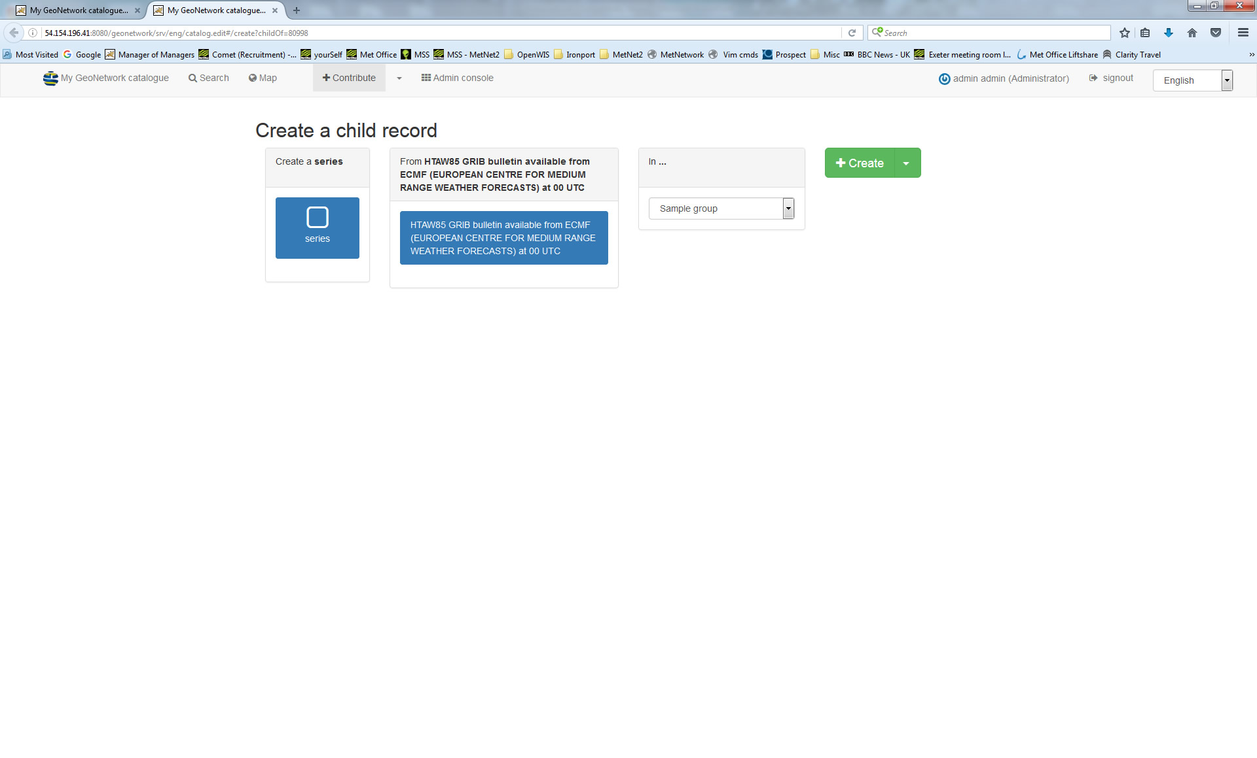
Metadata Options (for Editors)
Notes:
Here Editors can:
Transfer ownership of a record
Create a child – groups datasets in a series.

Slide 9
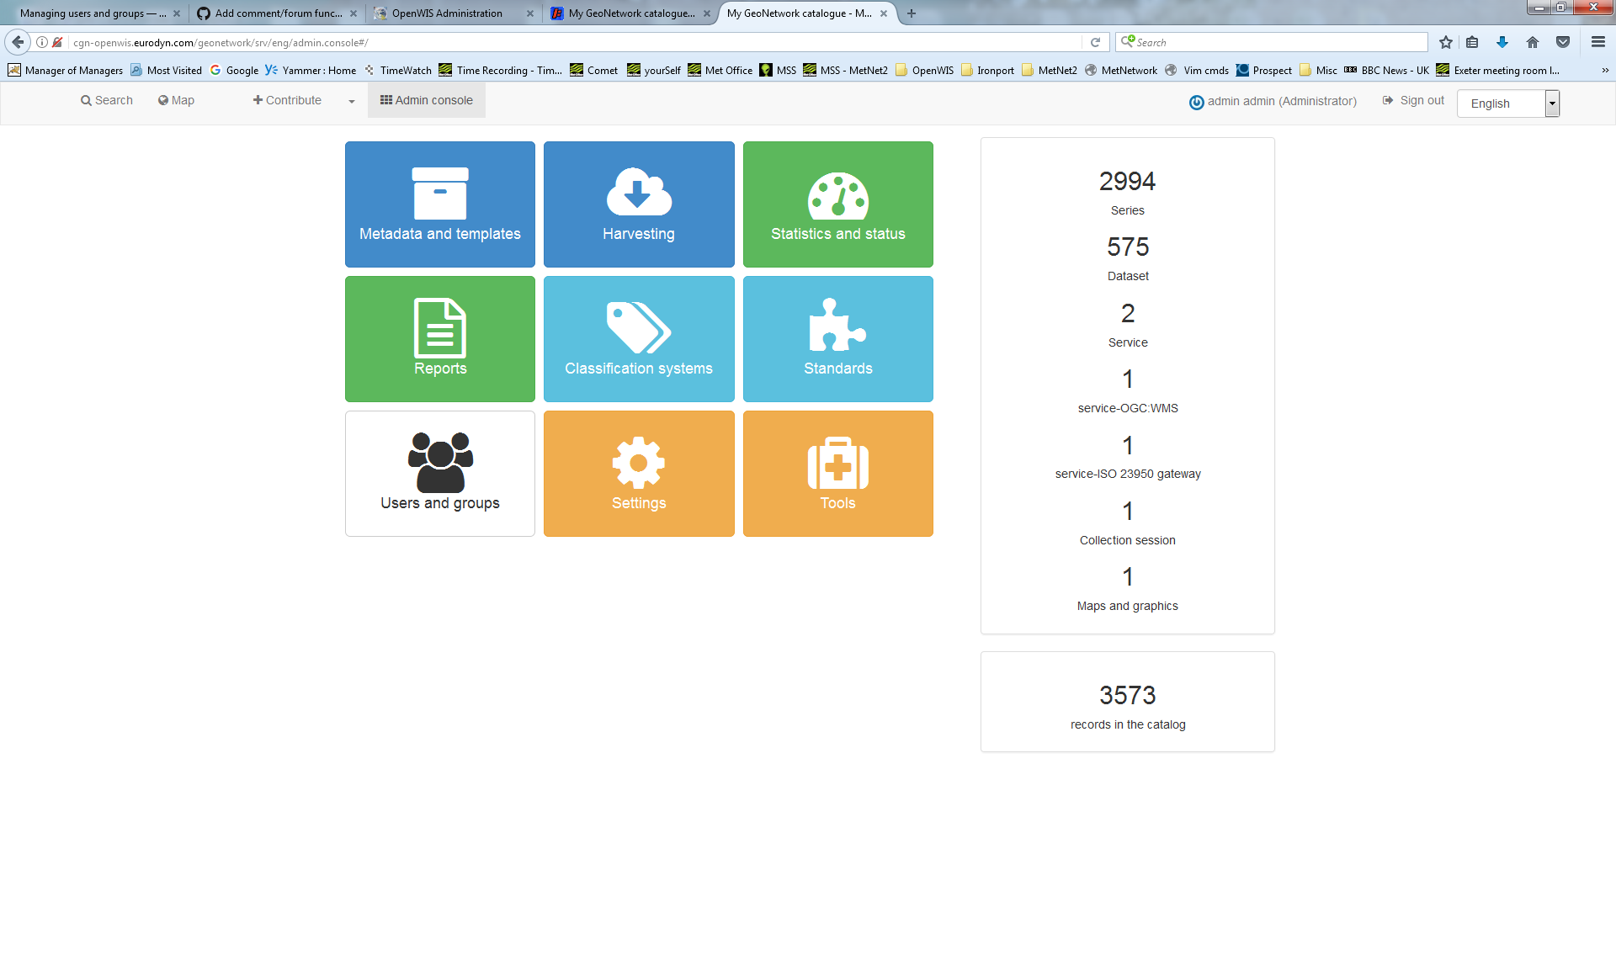
Admin Page
Notes:
Won’t go into everything here so we’ll look at the more interesting ones.
Right side – Totals Summary - looks like it shows the Browse Resources/Types as seen on the Main Page – seems to be generated from ‘Hierarchy Level’ section in Metadata
But there’s more here than on the Main Page – hence question about how many can be shown there.

Slide 10
Groups, Roles & Privileges
The catalogue uses the concept of Users, Groups and User Profiles.
A User can be part of one or more Groups.
A User has a Role in a Group.
The Administrator Role is not related to a Group.
The combination of Role and Group defines what tasks the User can perform on the system or on specific metadata records.
Users can have different roles in different groups. A role defines what tasks the user can perform.
Roles are hierarchical and based on inheritance. This means that a user with an Editor profile can create and modify new metadata records, but can also use all functions a Registered user can use.

Slide 11
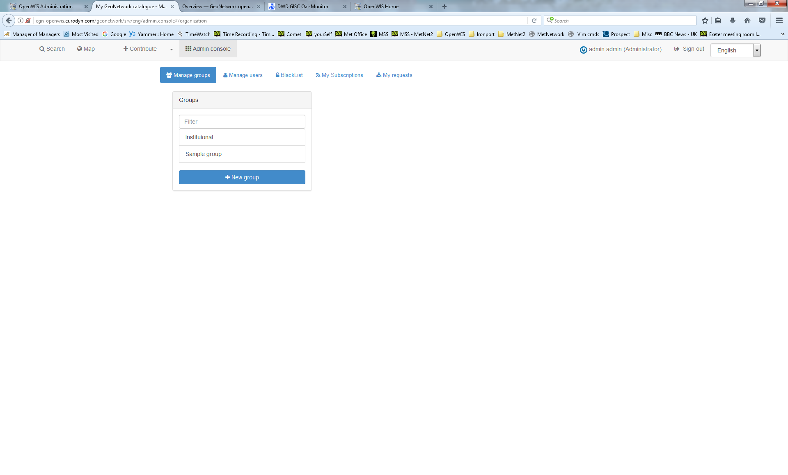
Groups
Notes:
Here’s what there is currently
Groups are used for what metadata admin/user can access – not privileges that apply to that group - they are applied separately. There is no overall group privilege as in v3.14

Slide 12
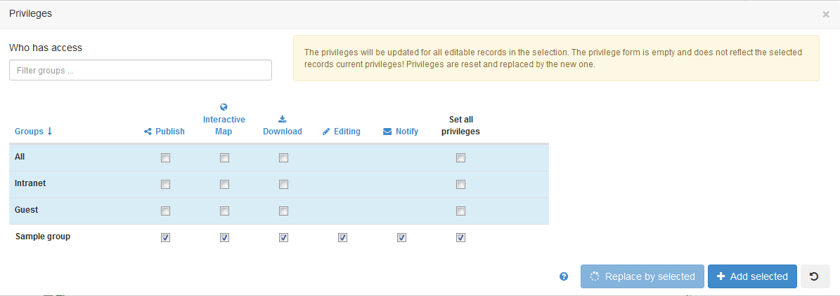
Privileges
Group Privileges don’t appear to be configured independently as in v3.14
(But does only relate to access to the metadata not cache data.)
Privileges can be set on a selected set of records in the search results.
The following rules apply:
the groups are those that the user belongs to
the privileges specified will only be applied to records that the user has ownership or administration rights on - any other records will be skipped
the current records privileges will be reset and replaced by the one selected
Notes:
NOTE: Privileges to groups All and Intranet are not transferable.
Also –we still need to somehow add access privileges for the Cache Data
ie Metadata should be discoverable but data related to it may not accessible due to privileges.
Setting Privileges seems to be an extra, manual, process using the Search Results page after creating metadata. It’s not based on the Group that the metadata is in.
This is very clunky and is impractical. (synchronising doesn’t apply privileges automatically) This also needs to be looked at as it has no bearing on cache data.

Slide 13
Roles
Administrator Profile
User Administrator Profile
Content Reviewer Profile
Editor Profile
Registered User Profile
Notes:
User Administrator and Content reviewer Profiles stand out for me.

Slide 14
Administrator Profile
The Administrator has special privileges that give access to all available functions.
These include:
Full rights for creating new groups and new users
Rights to change users/groups profiles
Full rights for creating/editing/deleting new/old metadata
Perform system administration and configuration tasks.
User Administrator Profile
The User Administrator is the administrator of his/her own group with the following privileges:
Full rights on creating new users within the own group
Rights to change users profiles within the own group
Full rights on creating/editing/ deleting new/old metadata within the own group
Notes:
We know what these are but

Slide 15
Content Reviewer Profile
The content reviewer is the only person allowed to give final clearance on the metadata publication on the Intranet and/or on the Internet:
Rights on reviewing metadata content within the own group and authorising its publication
Editor Profile
The editor works on metadata with following privileges:
Full rights on creating/editing/ deleting new/old metadata within the own group
Registered User Profile
The Registered User has more access privileges than non-authenticated Guest users:
Right to download protected metadata (not data – yet)

Slide 16
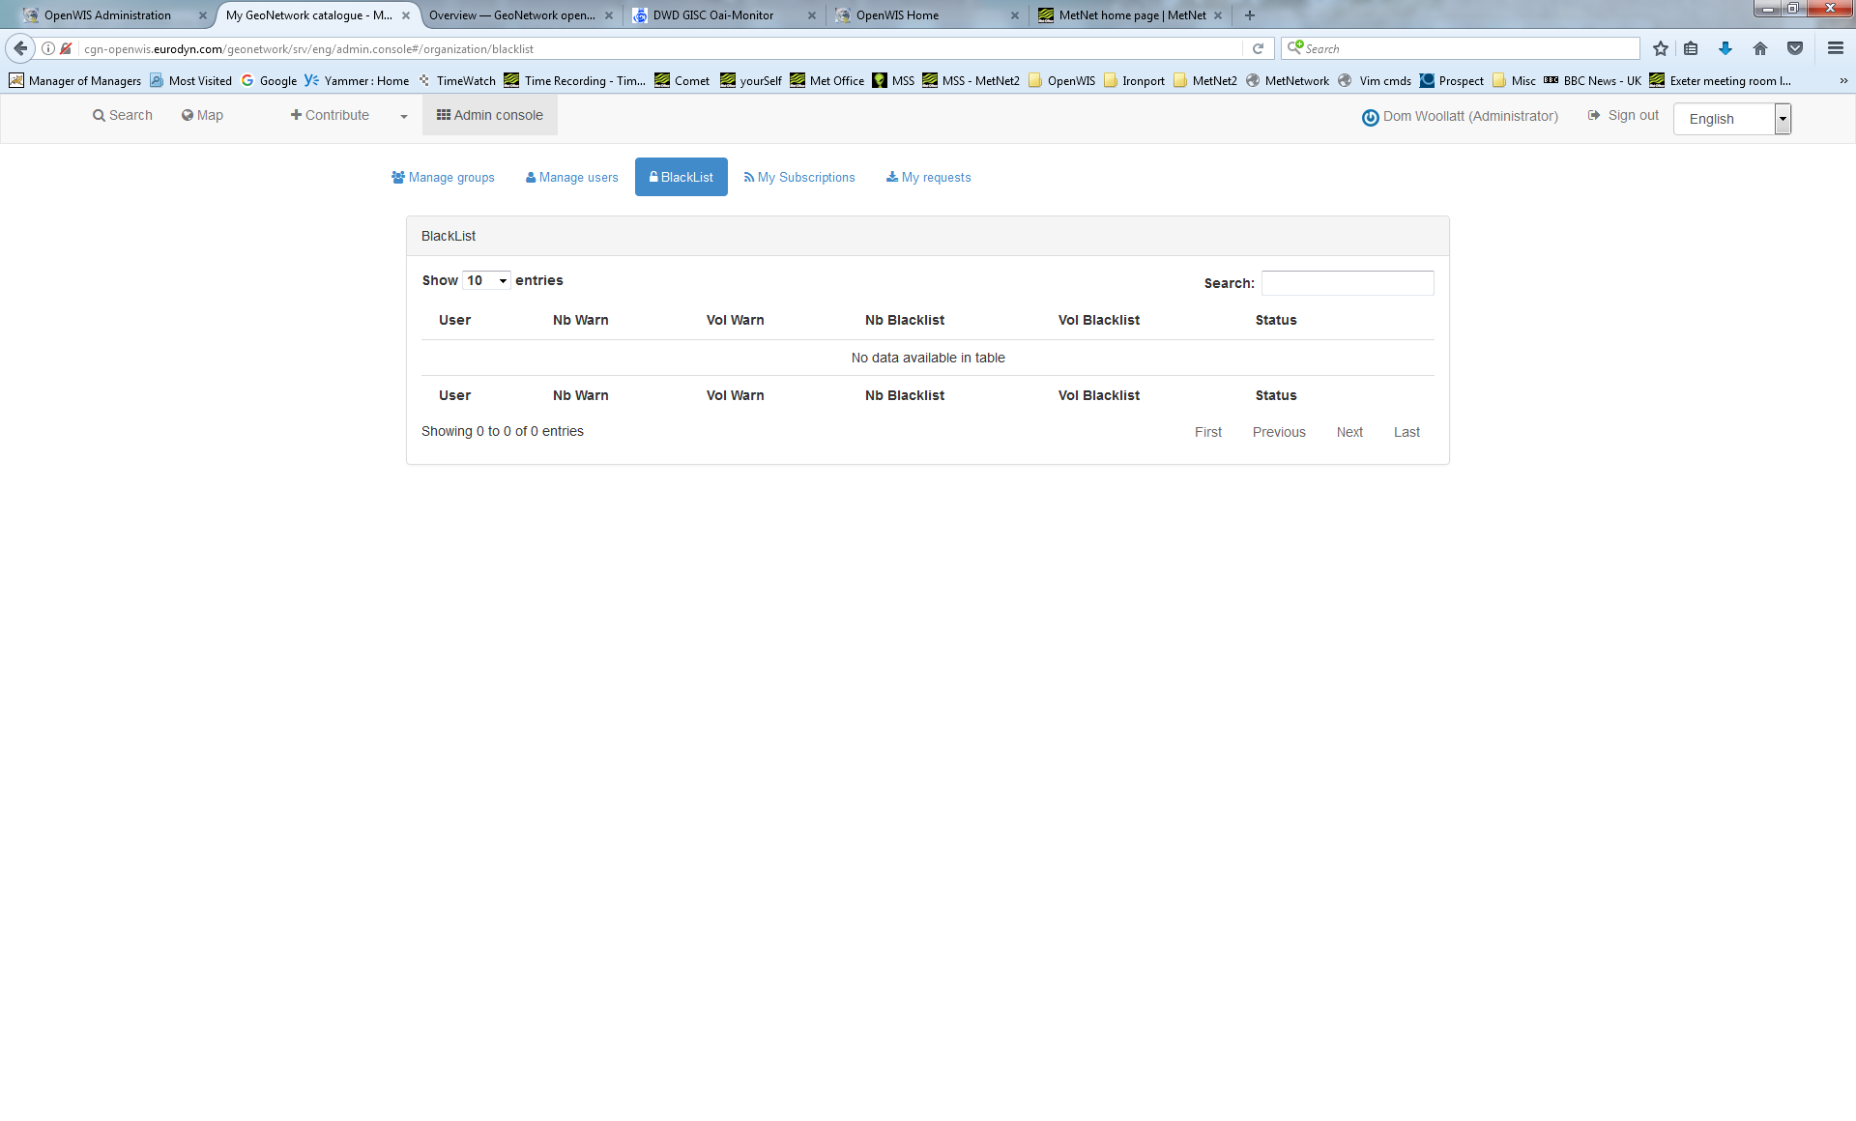
Blacklisting
Notes:
There doesn’t appear to be any settings to manage.
More development needed?
But I’m not sure it is relevant for WIS.
All catalogue can be subscribed to – what is purpose of blacklisting? discuss

Slide 17
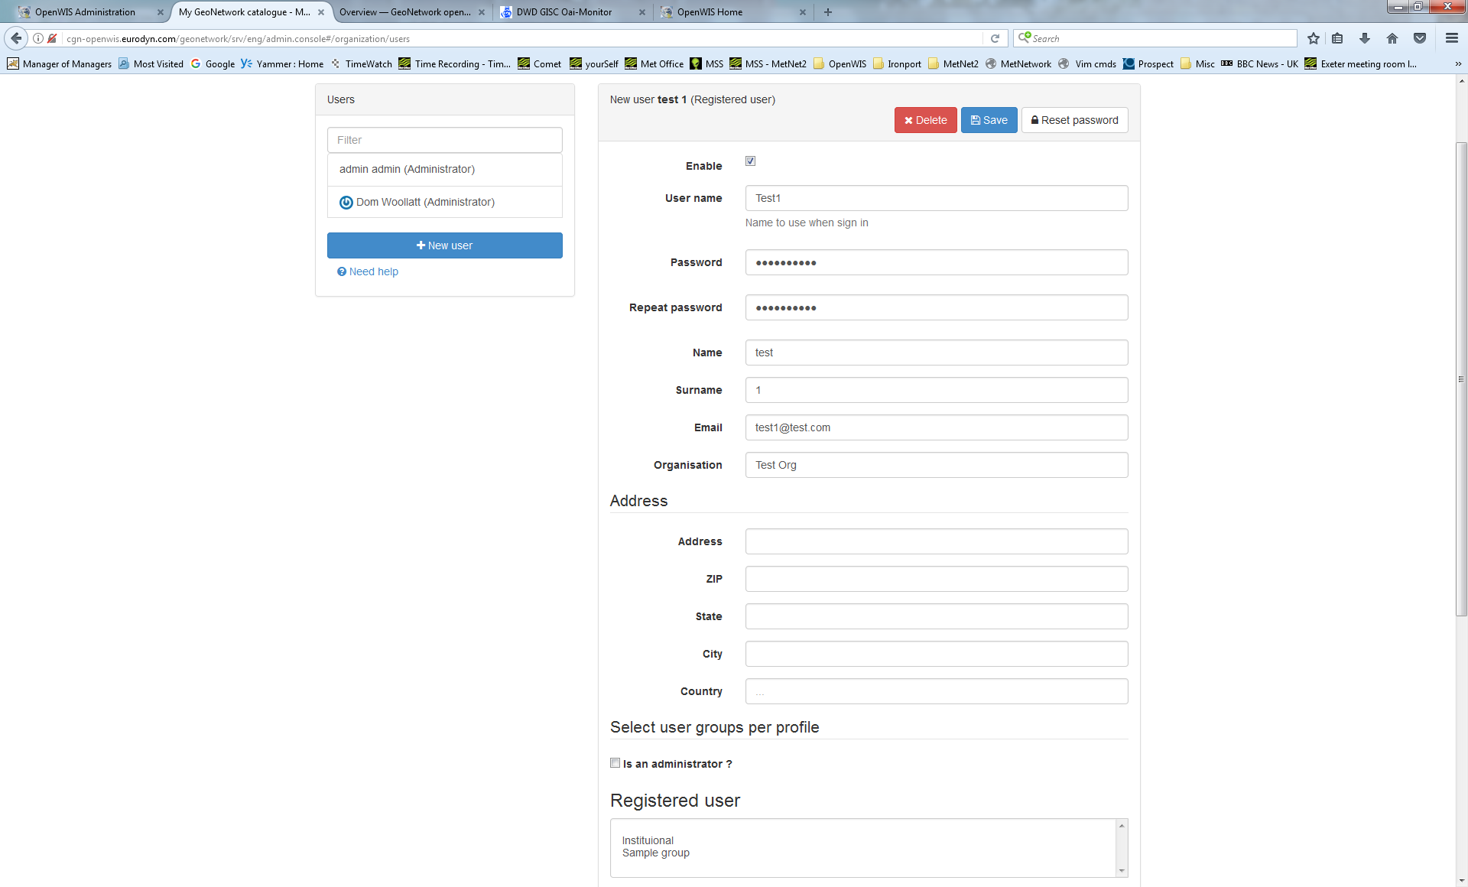
Users
Notes:
This shows where users are added to groups (more than one could be useful in future?)
No Class of Service or Favourites – meaning email address/ftp server
Blacklisting info?

Slide 18
Managing categories
Categories separate metadata into groups, without changing the actual content of the metadata.
Categories can be used to filter a search result, or limit the output of a custom csw endpoint.
A category needs to be assigned to a metadata document
Available categories can be modified
Note: If you add or modify categories, they may not obtain an appropriate icon. These icons are managed in /catalog/style/gn_icons.less. In this file category-classes are mapped to font-awesome variables that map to a certain font-awesome icon (http://fontawesome.io)

Slide 19
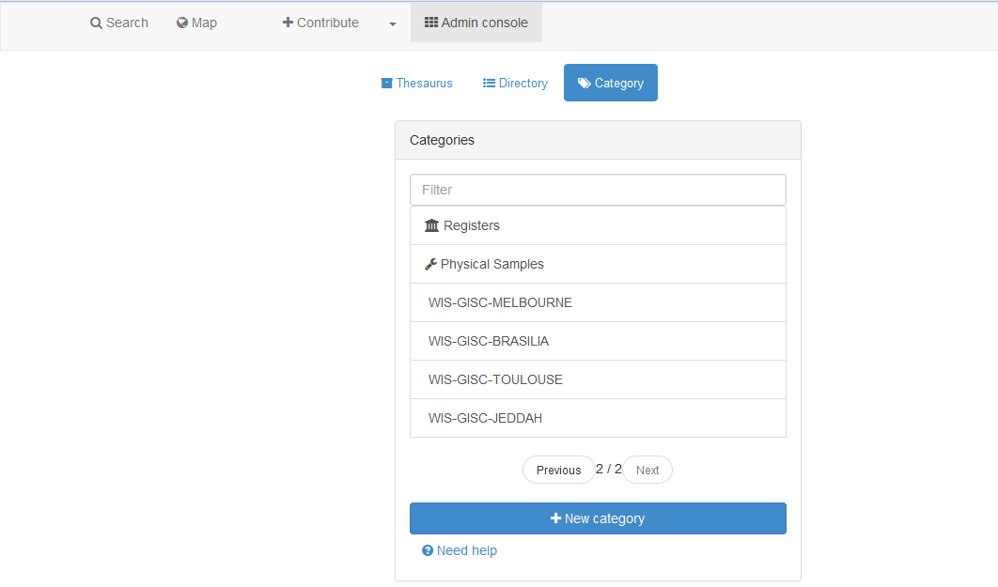
Categories
Notes:
Categories are used by us for harvesting from other GISCs.
I like the little icons
It would be nice to have logos for the other GISCs made
Current example – this is where the GISC names are to be added for the Harvest Tasks.
As well as ‘draft’ option?

Slide 20
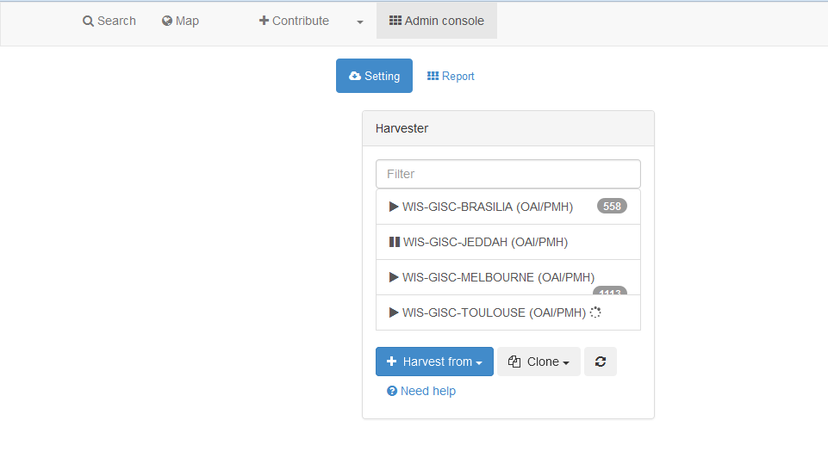
Harvesting
Notes:
Documentation pretty poor on this. Still using 2.10 info, but is completely different interface

Slide 21
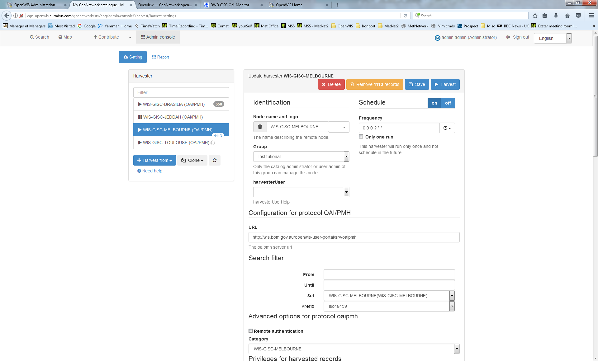
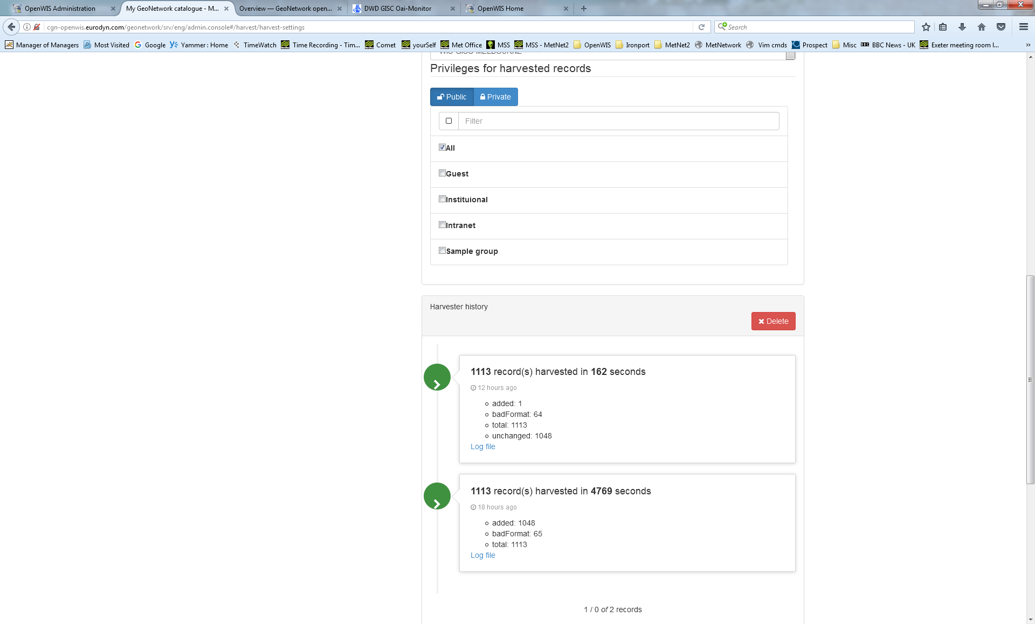
Harvesting cont...
Notes:
Layout ok
Totals seem messed up – can see 1113 for Melbourne – but it actually has 1048 in this case.
Seems to have harvesting and synchronisation on a single page. Is it synchronisation though rather than a re-harvest? It seems that subsequent runs are much faster than the first harvest, so indicates that it might be synchronising.
When is validation carried out. What is it validating to? It seems to be have to be done manually afterwards (on Contribute page)
Though some validation must be happening for the few that have “badFormat” ?
Can set the access privileges here for the metadata – but it would always be ALL?
NOTE: Privileges to groups All and Intranet are not transferable.
Also –we still need to add access privileges for the Cache Data
Intranet and Guest seem to have been added to the Groups list, but I suppose these are defaults and not configurable in the GUI.
We can see the time difference in the time taken here but the log file for both seems to be identical (except for date/timestamps) with Mk1 Eyeball.

Slide 22
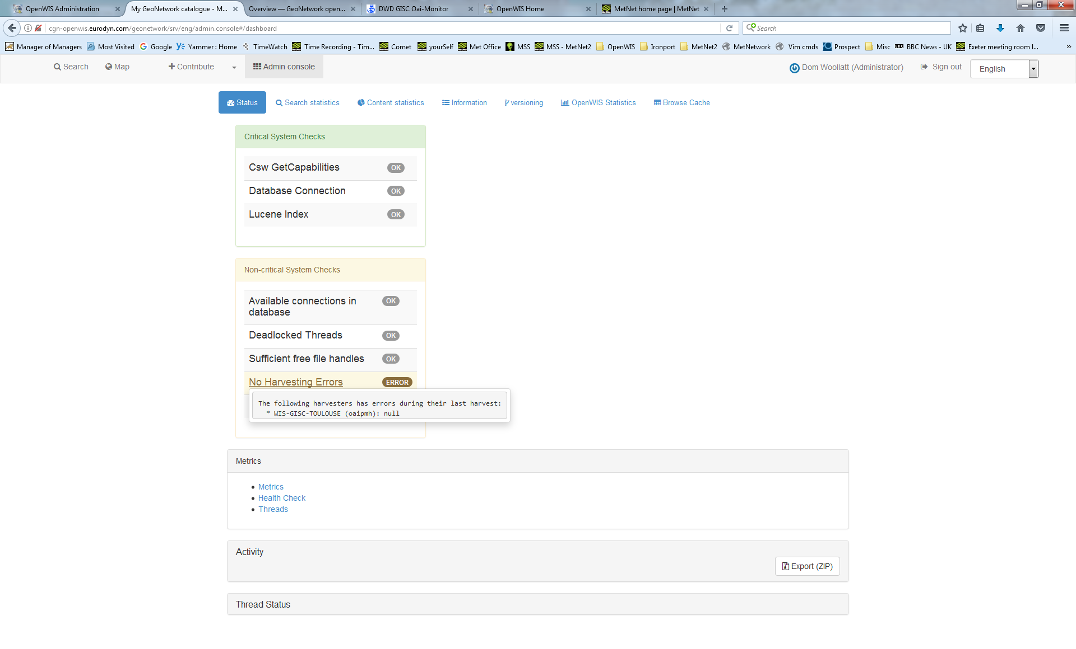
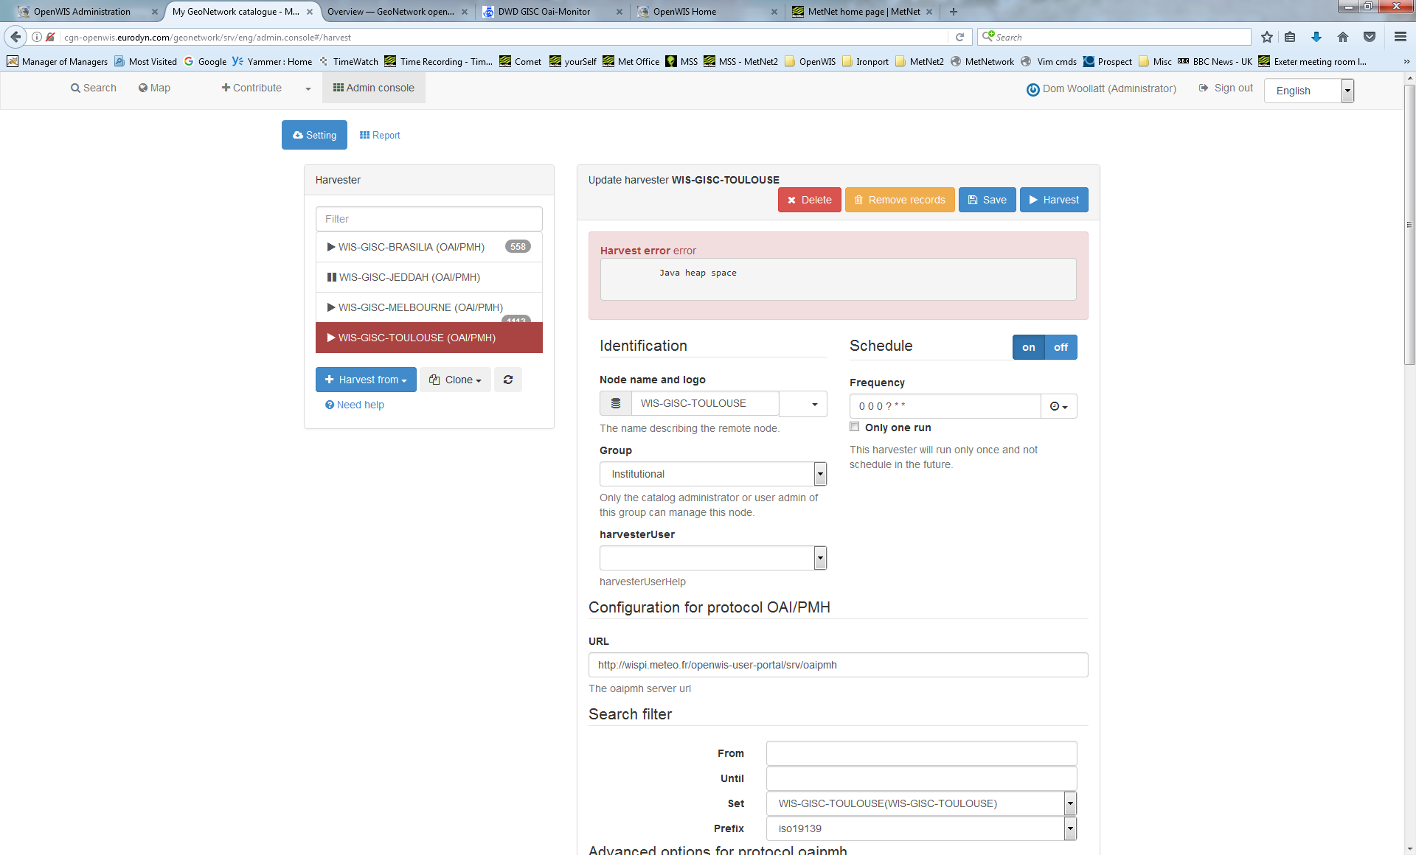
Harvesting cont...
Notes:
Seems there was a problem during the Harvest from Toulouse
We had an out of memory error.
Hopefully fixed by now

Slide 23
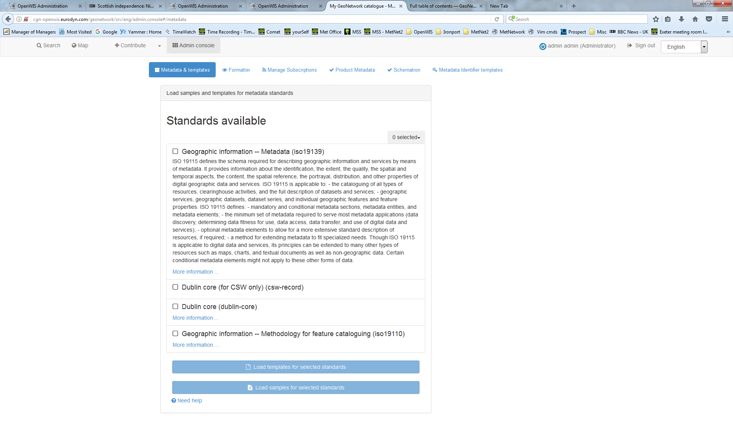
Metadata - Standards
Notes:
Metadata records in GeoNetwork are described by a schema. The schema sets out the structuring of the metadata record and provides all the ancillary data and functions to use the schema in GeoNetwork.
I notice there is a discrepancy here…. Supposed to be ISO19139 but shows ISO19115? So which is it?
There is a slight difference - ISO 19139 is an XML encoding of ISO 19115 with additions from ISO 19119 to cover metadata for services that provide geospatial data

Slide 24
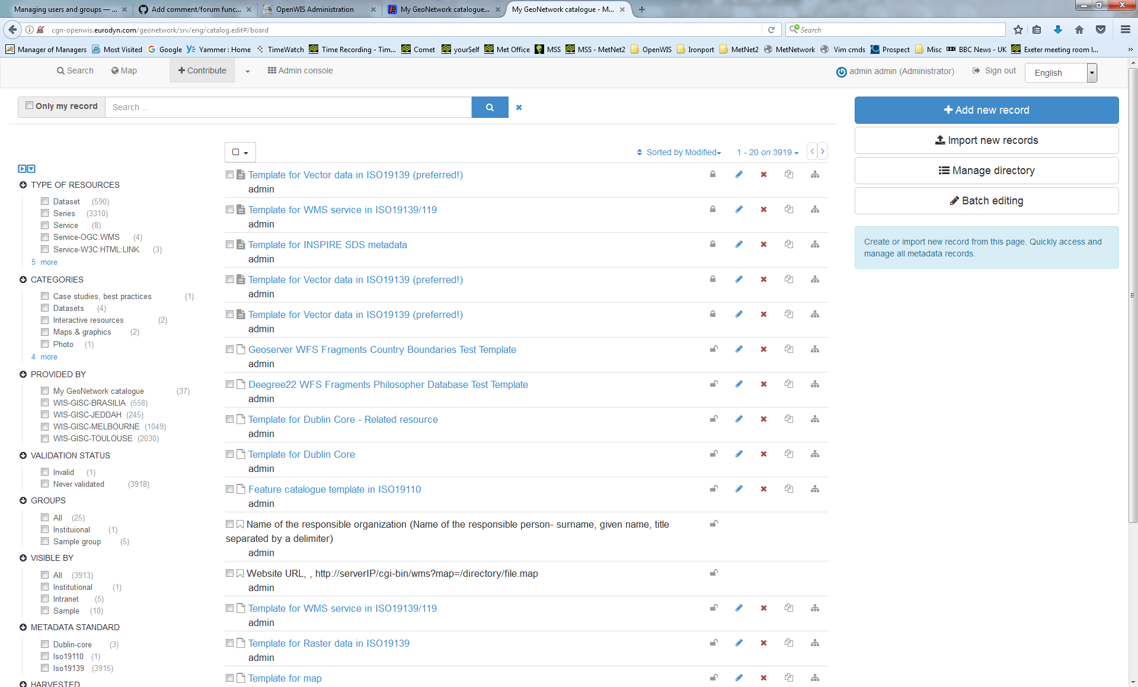
Adding Metadata
Notes:
Add new records manually

Slide 25
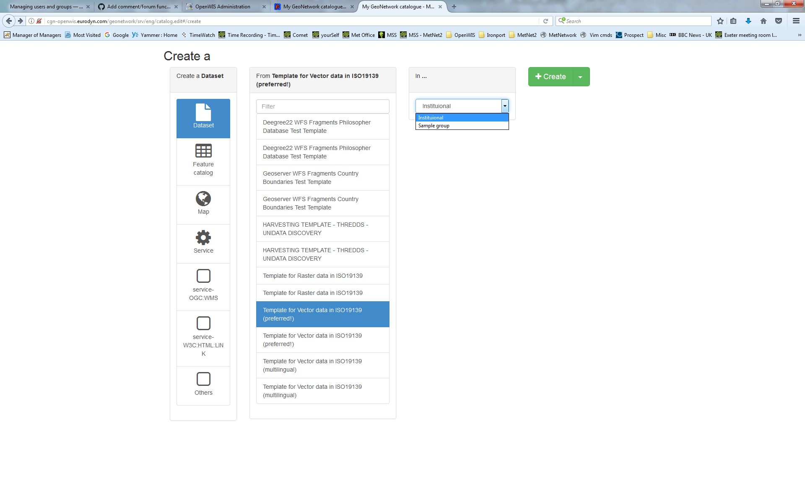
Adding Metadata cont…
Notes:
No too sure which “Create a” to start with.
It seems a little more convoluted than in v3.14
How do we add the OpenWIS metadata template as well as Stop-Gap Template?
Also what about Stop-Gap Metadata? Do we still need it?
Notice category isn’t available here. That’s selected on the metadata screen (next)
But here you choose the Group or groups.

Slide 26
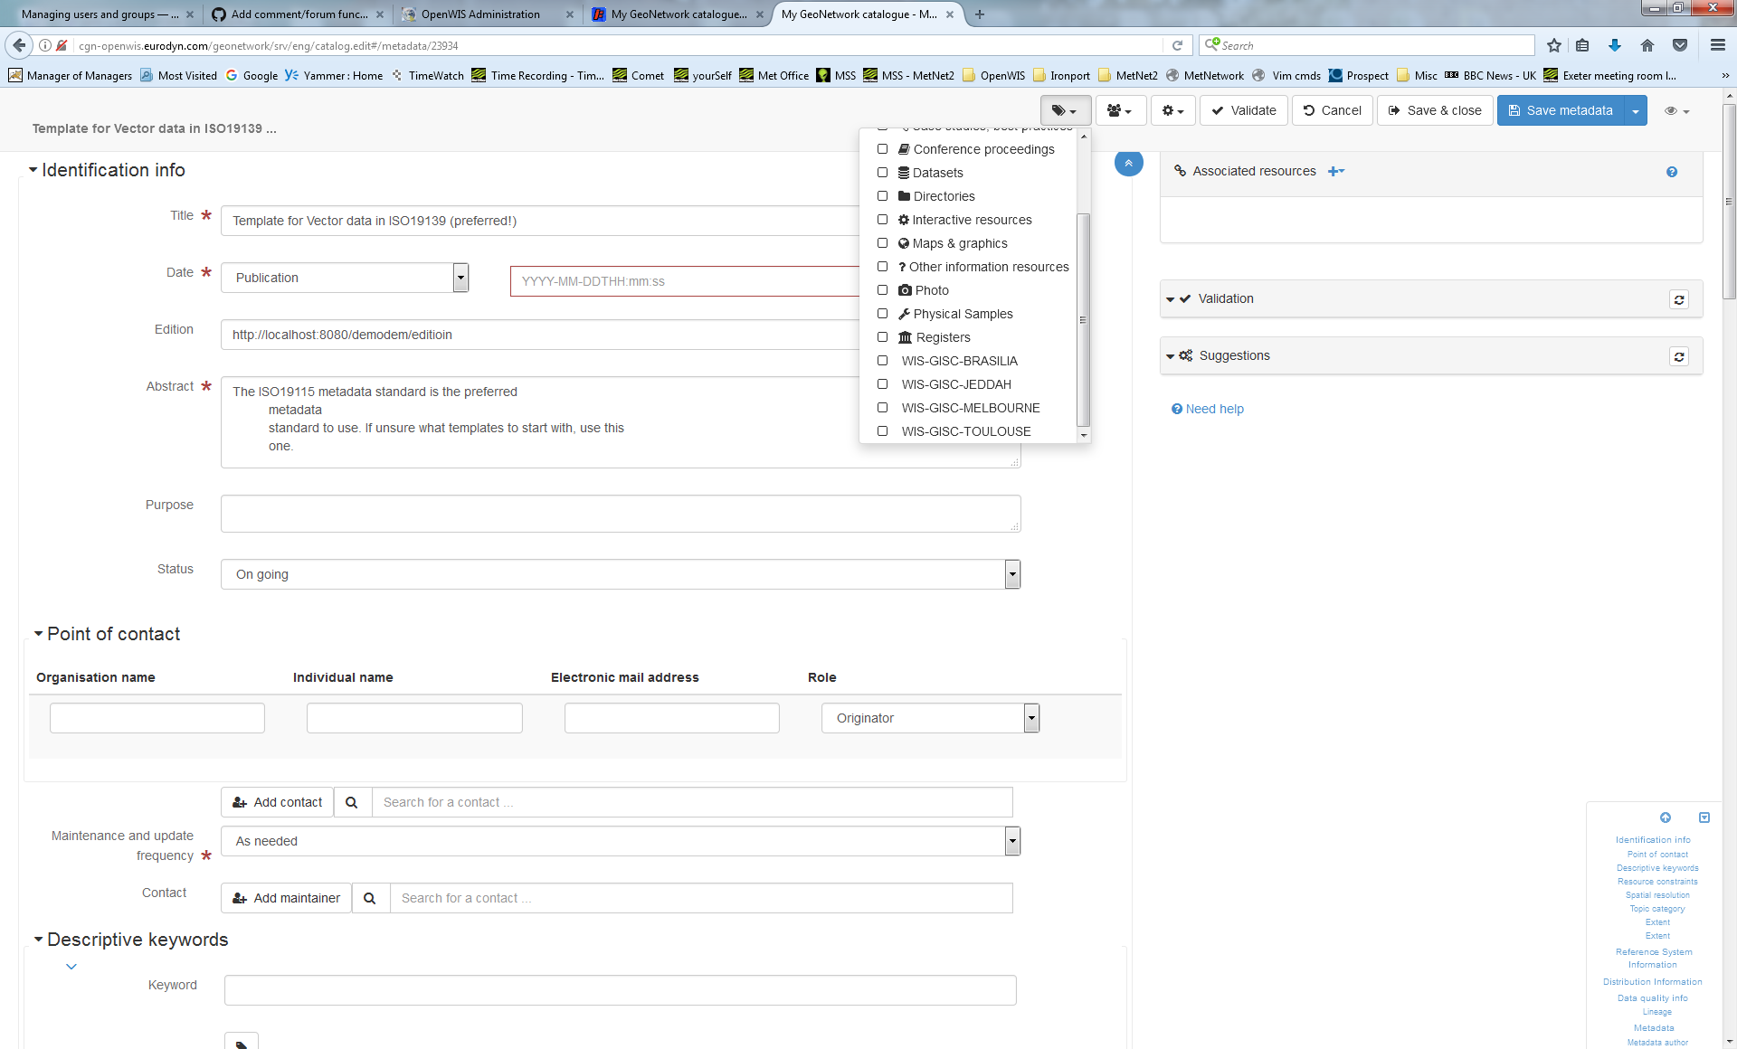
Adding Metadata cont…
Notes:
Seems ok
But I’m no expert.
Can add it to category now.
Validation is available here. Whatever it validates too – ISO19139?

Slide 27
Importing Metadata
Notes:
Import new records

Slide 28
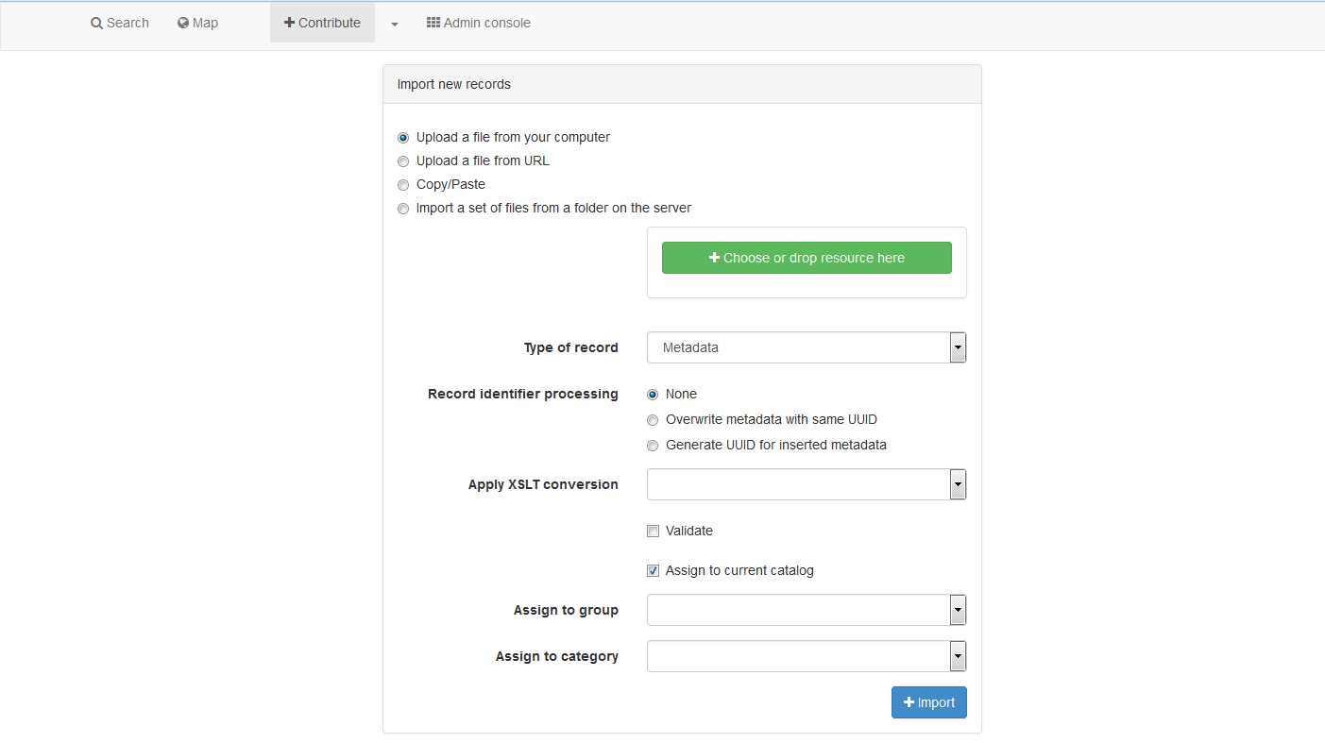
Importing Metadata cont…
Notes:
Seems ok.

Slide 29
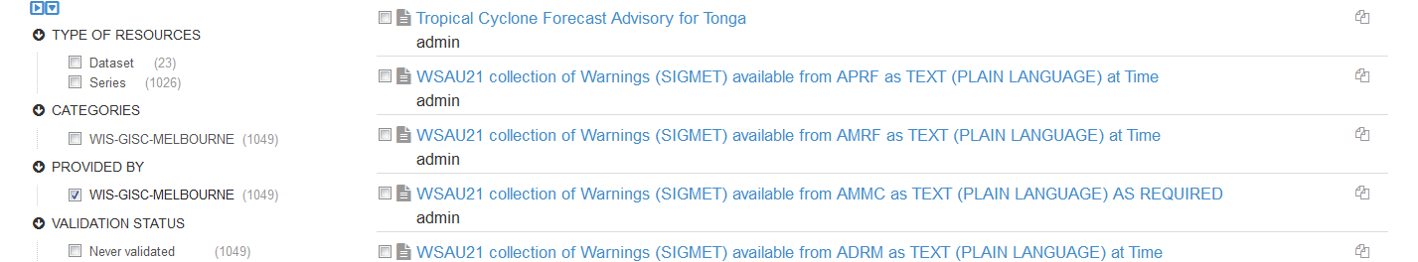
Edit Metadata
Notes:
NOTE: Seems that the owner is whoever harvested the metadata – not the owner of the Metadata. BAD!
Option: Privileges/Edit/Delete/Duplicate/create a child
Not able to edit Metadata that’s been harvested - only get to Duplicate
This might need to be amended somehow. Admins should be able to amend harvested records. Eg user privileges
How is WMO Essential and Additional recognised?

Slide 30
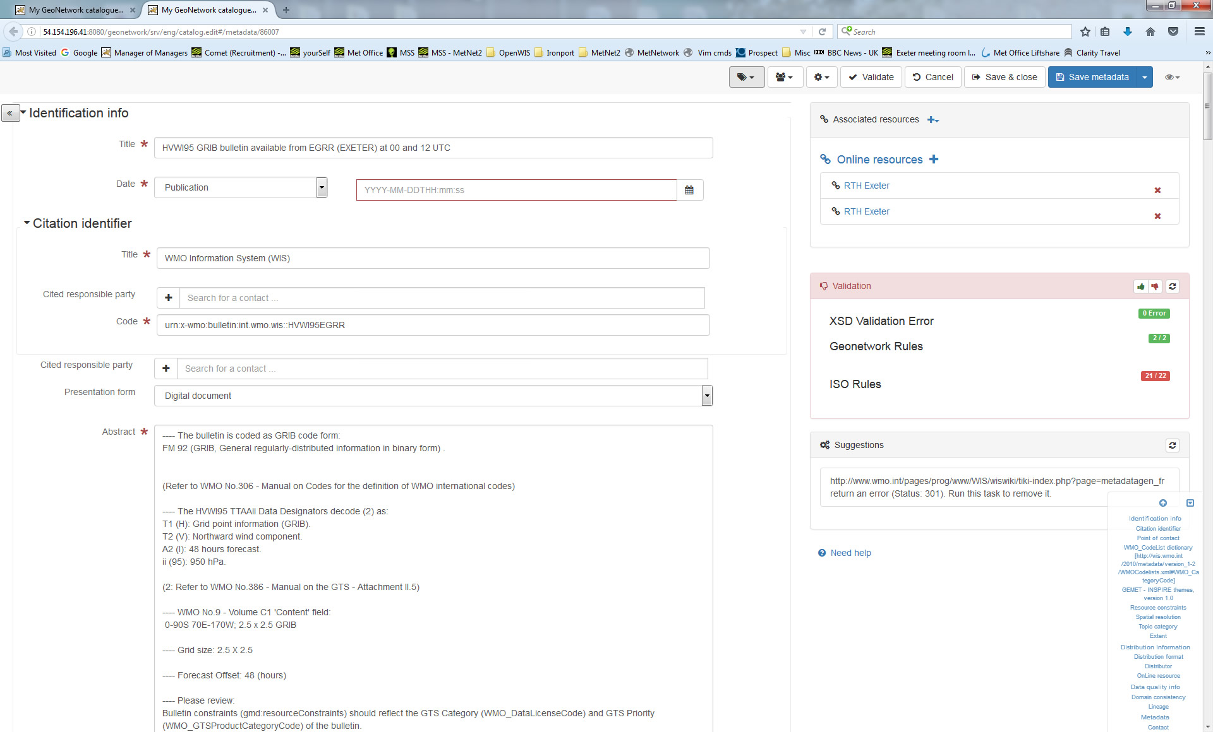
Edit Metadata cont…
Notes:
For those that can be edited – can change anything.

Slide 31
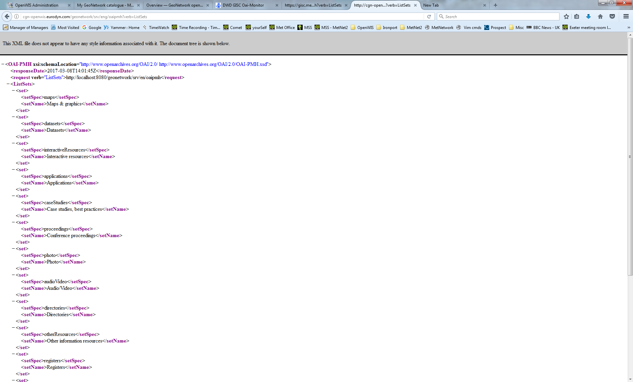
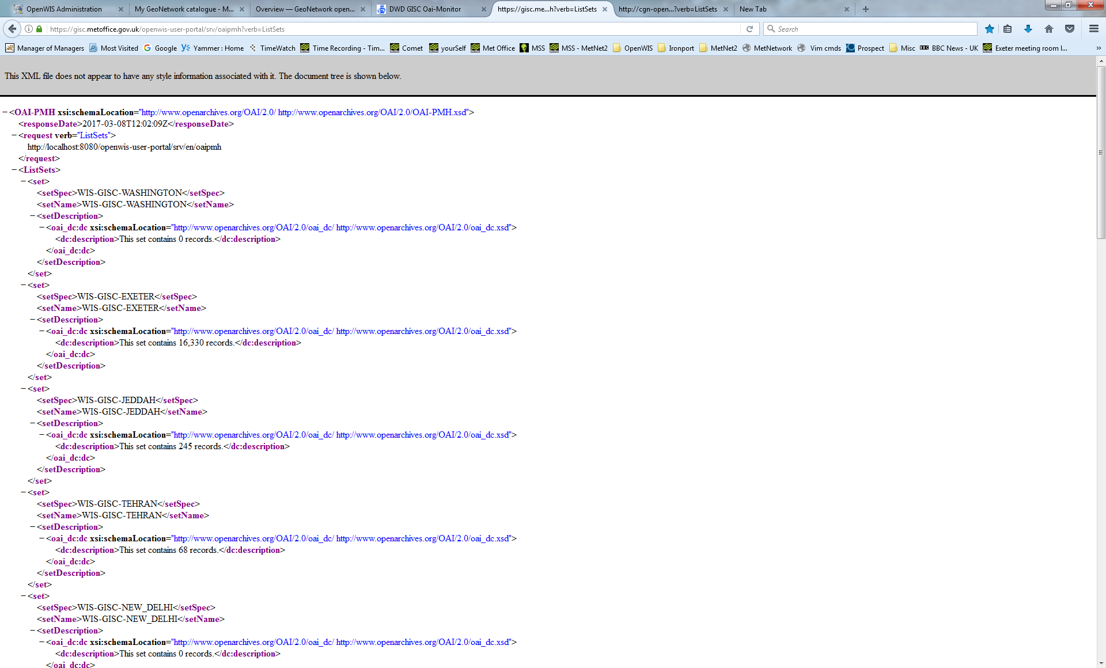
OAIPMH
Notes:
What about harvesting from this system?
http://cgn-openwis.eurodyn.com/geonetwork/srv/eng/oaipmh?verb=ListSets
Compare with
https://gisc.metoffice.gov.uk/openwis-user-portal/srv/oaipmh?verb=ListSets

Slide 32
Life Cycle
Metadata records have a lifecycle that typically goes through one or more states. For example, when a record is:
created and edited by an Editor user it is in the Draft state.
reviewed by a Content Reviewer user it would typically be in a Submitted state.
completed and corrected by the Content Reviewer it would be in the Approved state and may be made available for casual search and harvest by assigning privileges to the catalog All group.
superseded or replaced and the state would be Retired.

Slide 33
The catalog has (an extensible) set of states that a metadata record can have:
Unknown - this is the default state - nothing is known about the status of the metadata record
Draft - the record is under construction or being edited.
Submitted - the record has been submitted for approval to a content review.
Approved - the content reviewer has reviewed and approved the metadata record
Rejected - the content reviewer has reviewed and rejected the metadata record
Retired - the record has been retired

Slide 34
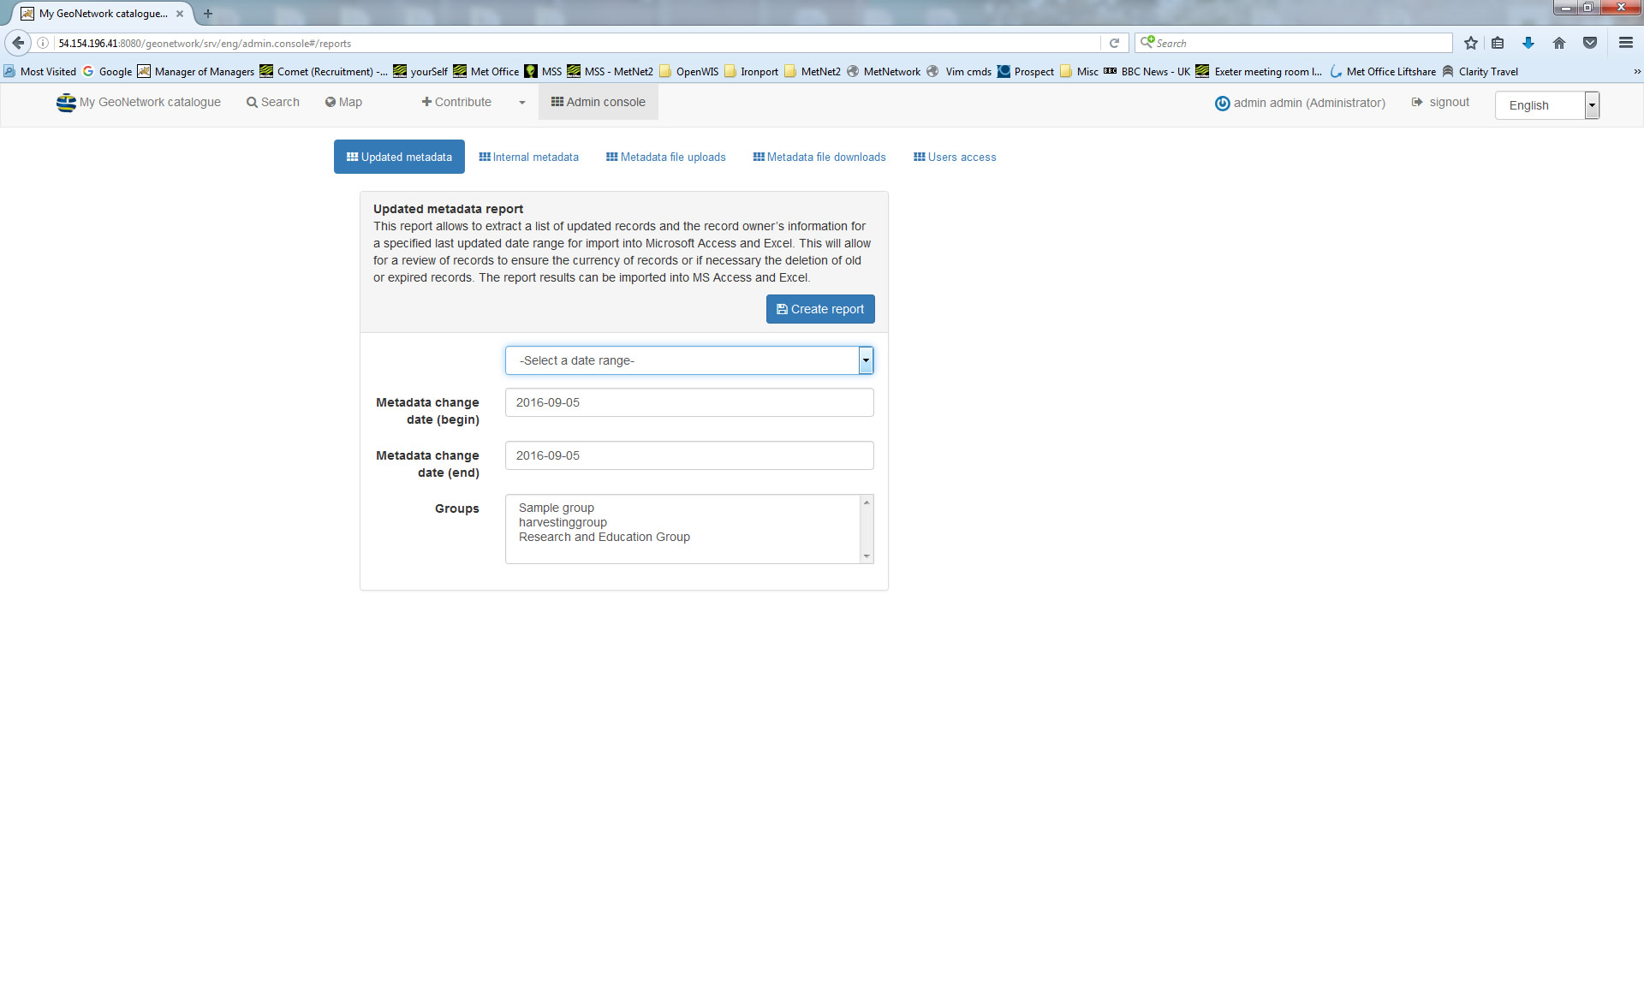
Reports
Notes:
Selection of reports available – maybe these will be of use?

Slide 35
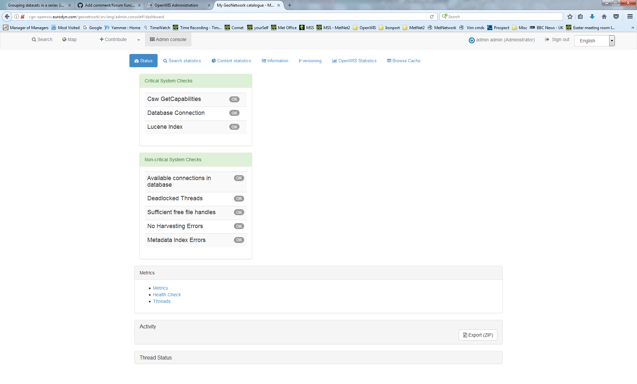
Status / Statistics
Notes:
Do get a little more with a tooltip when there’s an error. (not shown here)
Search and Content Statistics are nice, pretty pie charts, but not too sure how useful.
Info and versioning just provide info.
OpenWIS Stats and Browse Cache not working (at the time of writing)

Slide 36
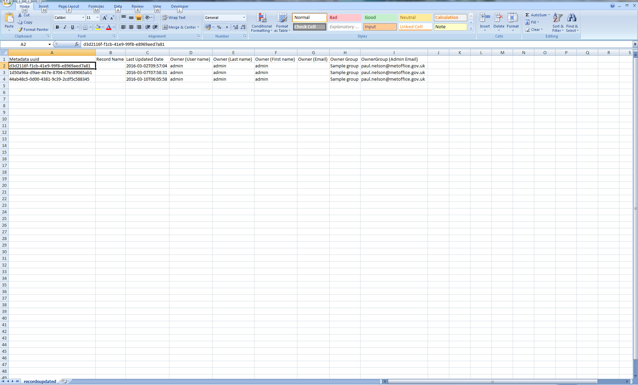
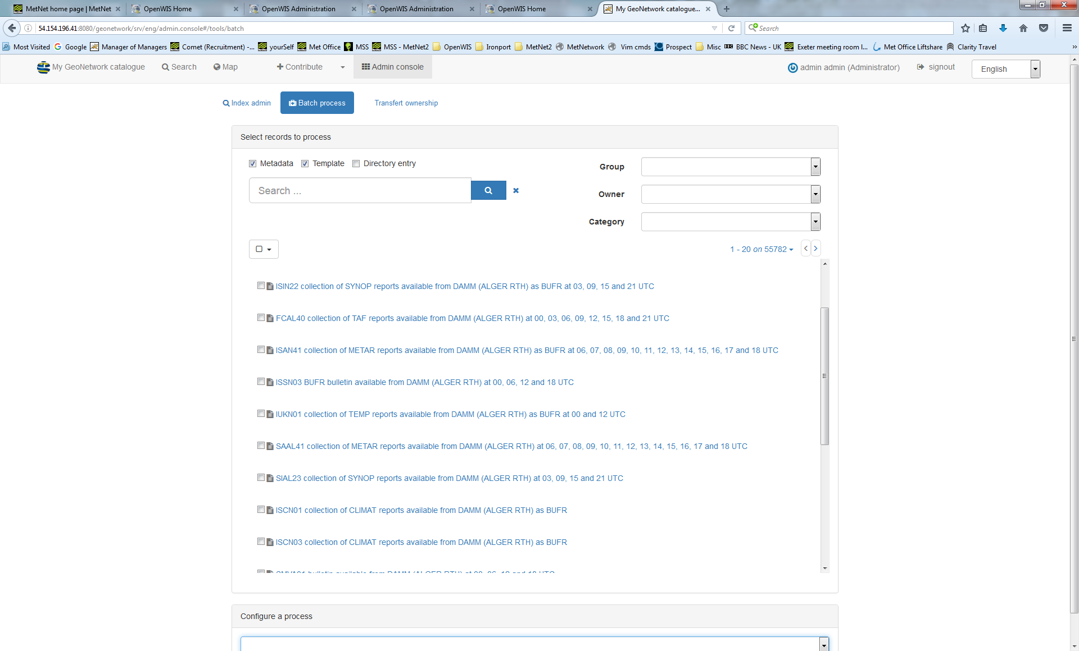
Tools - Batch Process
Notes:
This looks to be very useful when batch modifying :
URLs
KeyWords
Contact names
Etc....
Note - cannot update these for harvested metadata. just Group and Category. Not Owner

Slide 37
What’s Missing?
GeoNetwork Documentation – out of date or missing
Separate Portals for User and Admin
Users
Class of Service
Favourites
Data Policy/Group Management/Privileges – for Data.
Groups
Global – True/False
Alarms page- Recent Events/Global Reports/User Alarms
Data Service – request monitoring, management , data ingestion
Search
via Lat/Long
Abstract
Map search – intersection/overlaps/within/crosses
Metadata – detailed harvest/synch reports/slow harvest– stop-gap metadata?
Subscription – process/delivery
Notes:
Much info missing or out of date.
Only one portal for both
Need more user details
Nothing configured for Data – only cache by the looks of it
Groups only relate users access to metadata – Global policy need adding?
No good info about managing issues, very little in GUI. Obviously nothing regarding Data.
All data management missing except ‘cache content’
Need to add options to ‘Search’
Lack of decent metadata monitoring/management
Basic subscription process – needs to be better.

Slide 38

Notes:
That’s me done
Anything else?

Slide 39
Any other thoughts?

